Slide 1
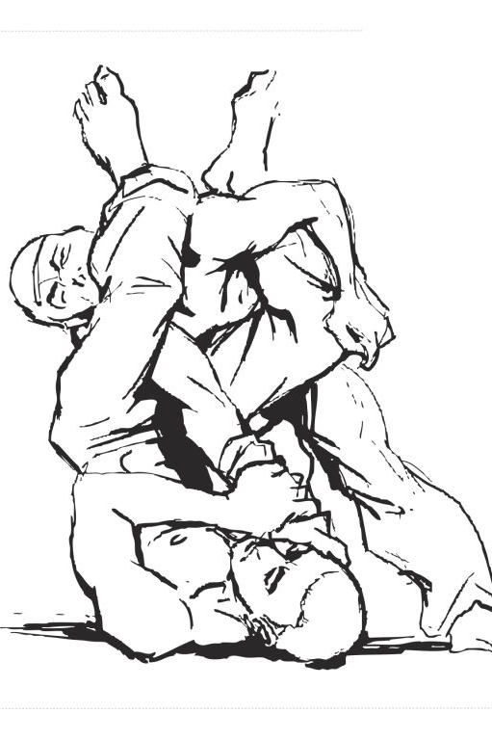
Jiu-Jitsu Buddy
A simple way to track your Brazilian Jiu-Jitsu Progress in Excel!
Coded by:
Yair Barranca

